Slide 1
Feedback, Dynamics, and Evolution in Clusters of Galaxies
Ken Cavagnolo
Thesis Proposal Presentation

Slide 2
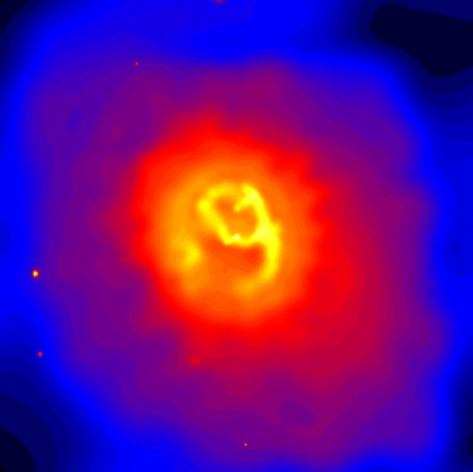
Density perturbations are created early in the Universe’s history from quantum fluctuations
Perturbations continue growing as overdense dark matter regions collapse under their own gravitational attraction
Baryons fall into the gravitational potential wells produced by the dark matter; potential energy of baryons is converted to kinetic energy; gas is thermalized to >10⁶ K producing a hot plasma (ICM)
This plasma emits strongly in the X-ray band and can be observed with Chandra, XMM-Newton, ROSAT, etc.
Notes:
Talk about:
Baryons trace the DM; tell about how gas becomes thermalized; thermalized means to lose energy by collisions and then reach a state that is well described by the Maxwell-Boltzmann distribution; ICM is the intracluster medium

Slide 3
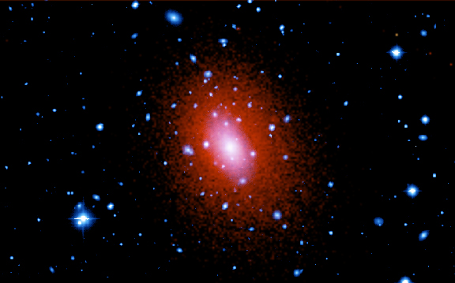
Composite optical and X-ray image of the galaxy cluster Abell 2029
(Kitt Peak and Chandra)
Entropy is the quantity most affected by changes in thermal energy of the ICM
The X-ray properties of the ICM enables study of gas entropy:
S=T/n_{e}^{2/3}
The formation, evolution, and number of clusters sensitively depend on cosmological parameters like Ω_{B}, Ω_{DM}, Ω_{Λ}, and the feedback/cooling mechanisms of clusters
We must quantify these feedback/cooling mechanisms to better understand these cosmological parameters

Slide 4
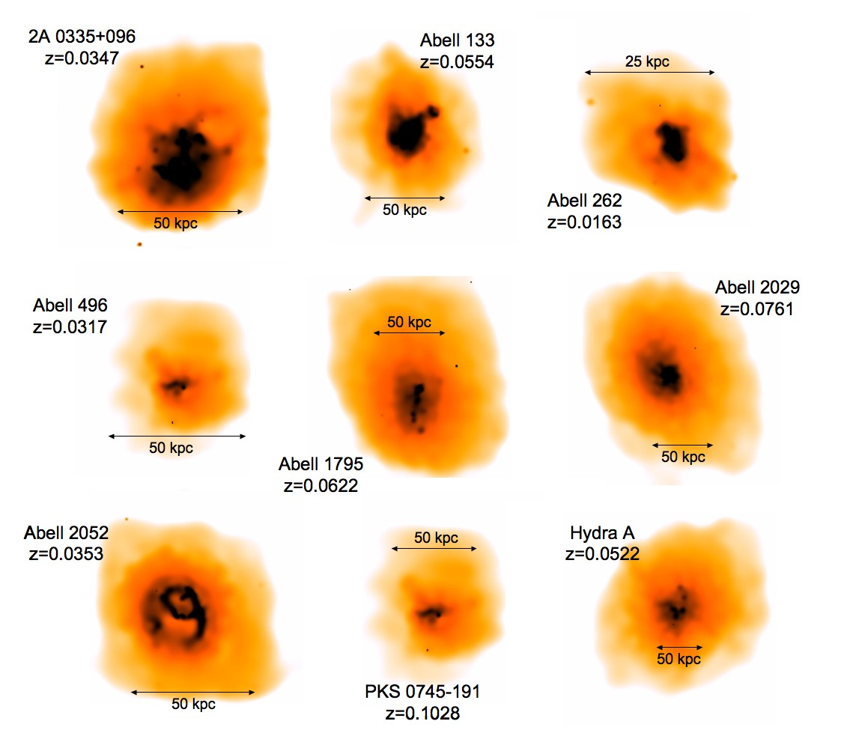
Cluster Sample
Clusters are taken from the Chandra Archive
Selection based upon greatest number of counts
Cuts made to select clusters with minimal amount of substructure and having a relaxed appearance

Slide 5
Cluster Sample
Sample contains low redshift clusters
  z = 0.01 - 0.1
  X-ray luminosity falls off as a function of redshift
Minimal substructure important since we are using radial binning
Substructure can come from a number of sources
  AGN
  Supernovae
  Star bursts
  Mergers
  Cooling flows
“Relaxed” clusters have simplest dynamics and appear virialized
Scale sizes for a cluster of galaxies:
  core is of order 20-200 kpc
  halo is order of several Mpcs
  Milky Way disk ~50 kpc; globular NGC 6304 ~5 pc

Slide 6
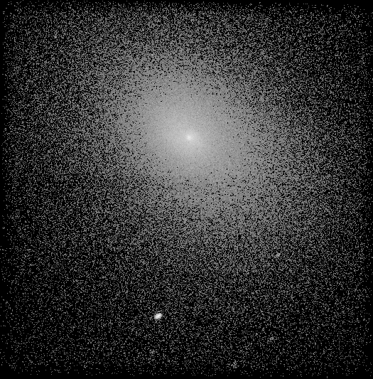
Data Reduction
Data from archived calibration runs of the ACIS chipset on Chandra telescope
ACIS-S3 back illuminated chip is more sensitive to soft X-rays
8.3’ x 8.3’ chip with resolution of 0.4920”/pixel
Point sources are in general background AGN or AGN within the cluster
Raw Chandra image of Abell 2029

Slide 7
Data Reduction
Cluster emission fills chip so we must use deep blank backgrounds as a surrogate for modeling the X-ray background
Background comes from soft X-ray (E<2keV) sources in the cosmos and a (E>2keV) cosmic ray component
To recover the soft and hard ends of spectra, we model the background
Raw Chandra image of Abell 2029

Slide 8
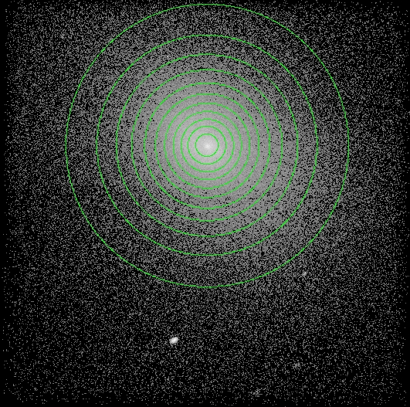
Data Reduction
Events files are cleaned of cosmic rays, flares, and point sources
Annuli containing 20,000 counts each are then constructed
Spectral extraction was then done on each of these radial bins
Local background used for outermost bin
Notes:
Talk about:
Flares occur at random and can increase the count rate by a factor of 100; source is unknown and unexpected; time intervals with flares are thrown out; none of out obs have flares; explain why bins were set-up to have 20K counts

Slide 9
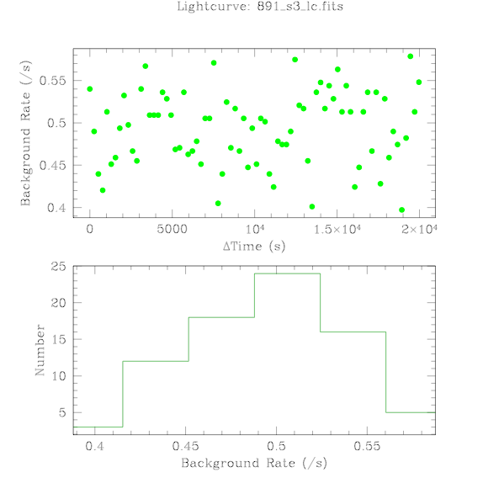
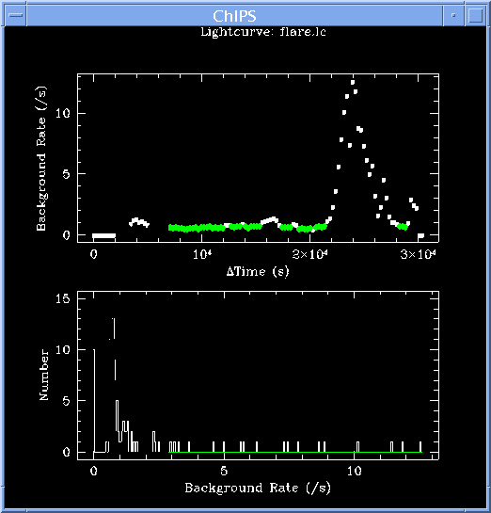
Data Reduction
Background flares occur at random
Source is unknown and unexpected

Slide 10

Data Fitting
Temperature fitting is done using the spectral model MEKAL within the program XSPEC
MEKAL is an emission spectrum for hot, diffuse plasmas
Free parameters are Galactic hydrogen column density (N_{H}), plasma temperature, metal abundance (Fe), and a normalization constant (N)
XSPEC uses the fitting technique of applying a spectral model and then fitting the model parameters to match the observed spectra
C(I) is counts as a function of channel; f(E) is the spectral model (MEKAL); R(I,E) is instrument response
R(I,E) is relatd to the probability for an event to occur in a channel

Slide 11
Data Fitting
Cannot use equation inversion because solutions are non-unique and unstable
Fit for MEKAL is done using free parameters until the “real” spectrum fits the observed spectrum
Questions to ask during fitting:
  Does the fit physically reproduce C(I)?
  Does the interval of the fit parameters make sense?
  How is deprojection altering the free parameters?

Slide 12
Data Fitting
We sought two temperature components in the cores of our cluster sample
One- and two-temperature projected fits were performed to determine which annuli were best fit with either one or two plasma phases
Exploration of parameter space used to assess effect of N_{H}, metallicity, and tying of parameter values across annuli
Modes of fitting used
  N_{H} fixed; free per annulus; free but tied across cluster
  Fe free per annulus; free but tied to neighboring annuli
  1T; 2T; 1T/2T
Deprojection then added to fitting models
  Observed emission is line of sight emission
  Assumes elliptical symmetry

Slide 13
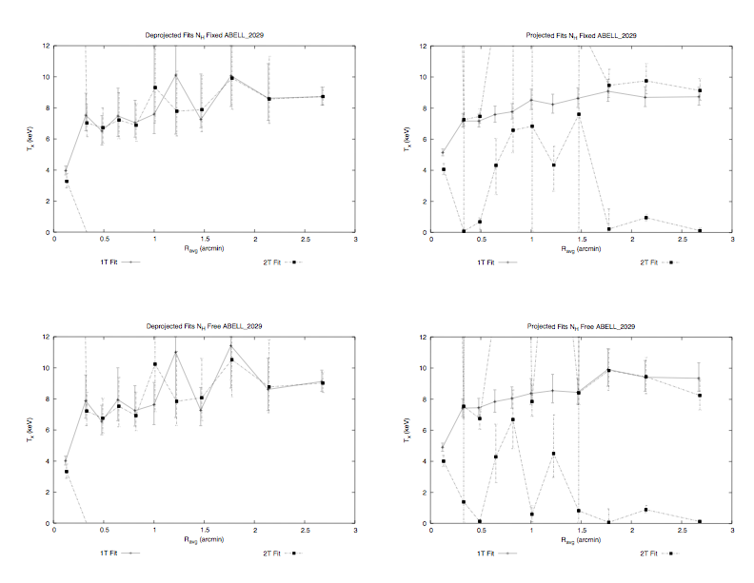
Notes:
Talk about:
Temperature gradients are consistent; how 1t fit traces a component of the 2t fit at every point; addition of 2nd comp in NH free models drives down NH and adds 2nd temp; some models had zero for their NH fit value;

Slide 14
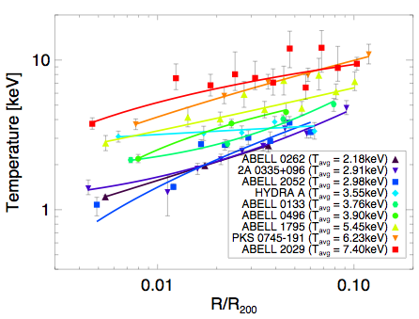
Data Fitting
Fit temperature as a function of scaled virial radius
Average temperatures are those taken from ASCA
Fits extend to deep within most cluster cores
Notes:
Talk about:
Power law feature of fits; R200 is the radius at which the density is 200 times the critical density and a good estimate of the virial radius;

Slide 15
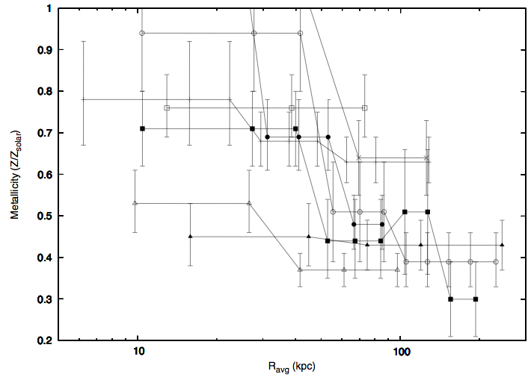
Data Fitting
Metallicity decreases as a function of radius
These gradients indicate processes in cluster cores are not mixing the gas

Slide 16
Data Fitting
1T and 2T fits used to watch how metallicity changed per bin
If neighboring bins behaved the same, they became tied
Tying also upped the number of counts used to calculate Z accurately because the calculation requires more counts
Enrichment has floor set by SNe Type II and further enrichment by SNe Type Ia
Metallicity gradients suggest mixing of gas is not taking place
Metal enrichment is widely predicted from SNe feedback, but should other feedback mechanisms be stirring the gas to a characteristic metallicity
  In other words, if AGN feedback is so powerful should we expect an impact on the gradients?

Slide 17
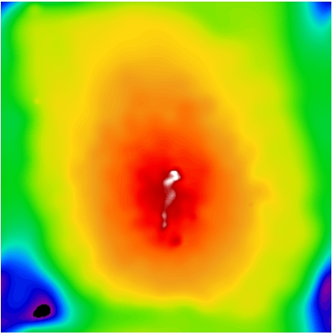
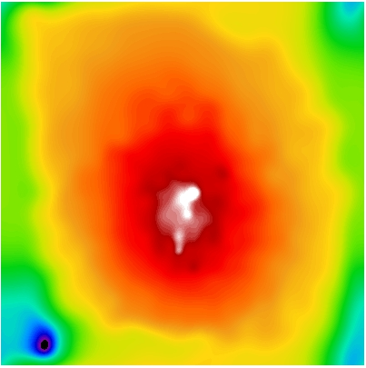
Data Fitting
Early (CALDB 2.26) fit runs produced multiple inner annuli for many clusters with two-temperature components
  Hot component associated with hard X-rays (2.0-8.0 keV)
  Cool component associated with soft X-rays (0.5-2 keV)
Soft emission in early versions of the CALDB was not well calibrated and we were mislead by results
E=0.5-2.0 keV
E=2.0-8.0 keV
Notes:
Talk about:
The ACIS-S chipset has a layer of “stuff” building up; this build-up affects the soft emission detection of the chipset; we saw this effect in our data; CALDB 2.28 corrected most of this problem; the emission at this end accounts for a significant portion of the cluster emission;

Slide 18
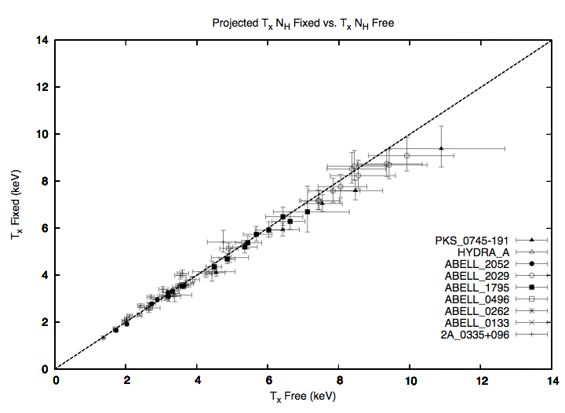
Data Fitting
N_{H} fixed versus N_{H} free fit temperature
Bias systematically increases for clusters with higher temperature
Relevant for global temperature measurements of hot, high redshift clusters

Slide 19
Data Fitting
N_{H} free biased the fit temperature to higher temps
Cosmology calculations are done with high mass clusters which reside in the higher temp regime
Effect has allegedly been corrected in CIAO 3.2 and CALDB 3.0

Slide 20

Results
XSPEC normalization related to electron density by:
Where N is normalization; D_{A} is the angular size distance; z is redshift; n_{e} is electron density; n_{H} is hydrogen density
Density is assumed to be constant within each annulus
  Is this assumption of constant density okay?
n_{H} is set to be n_{e}/1.2 because the gas is fully ionized
N=

Slide 21
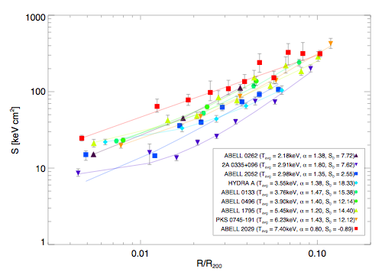
Results
Entropy profiles go as R^{1.32} in the core with a low central value
When extended deep within the core the entropy does not flatten out as predicted by theory.

Slide 22
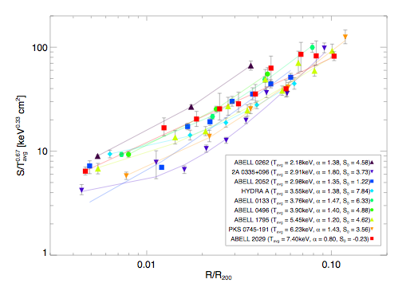
Results
Entropy floor exists from cooling and feedback removing gas from below the cooling threshold (S~100-150 keV/cm²)
Tightness of fits at large radii but breaking of similarity in inner regions

Slide 23
Results
S(r)=S₀+(r/r_{s})^{α} where S₀ is the initial entropy and r_{s} is an arbitrary scale radius
It is curious that the power law slope in the cooling/feedback dominated region of 0.1r₂₀₀ is so similar to the S∝r^{1.1} power law created by gravitational structure formation at r>0.1r₂₀₀
If heating is episodic in these clusters, then the time scale between episodes is 10⁷-10⁹ yrs
Notes:
Talk about:
Power law similarity at large radii vs. small radii for grav processes; episodic heating is calculated by …; does this episodic heating coincide with AGN outbursts or radio bubbles in our clusters?

Slide 24
Results
S(r)=A(r/<T>^{1/2})^{α} where A is a normalization value and r is in Mpc
Any model to compensate for radiative cooling must account for this S∝r slope in the region 0.01r₂₀₀-0.1r₂₀₀
The poor chi-squared in the model fits for 2A 0335+096 and Abell 2052 are related to the radio sources in their cores and the complex X-ray structure caused by these sources
Notes:
Talk about:
The scaling relation of s->r in the cores of clusters;

Slide 25
Questions
Why is the slope of entropy in the core, <0.1r₂₀₀, so similar to the slope at >>0.1r₂₀₀?
How does the projected appearance of a cluster relate to its virialized state?
Can we find observables that quantify a cluster’s position on the mass-temperature and mass-luminosity relations?
Is it possible to quantify the degree of virialization?
How well do deprojected quantities reflect the actual properties; does the assumption of symmetry in deprojection have a significant impact on our ability to accurately study clusters?

Slide 26
Future Work
Sample is being expanded to include more clusters because we now have a pipeline for this type of analysis
  XMM-Newton
  More Chandra archived clusters
Greater spatial resolution in temperature profiles
Further analysis by creating 2D temperature, entropy, density, and pressure maps
Comparing observations to 2D projections of 3D models from Gus Evrard’s Virtual Cluster Exploratory

